Slide 1
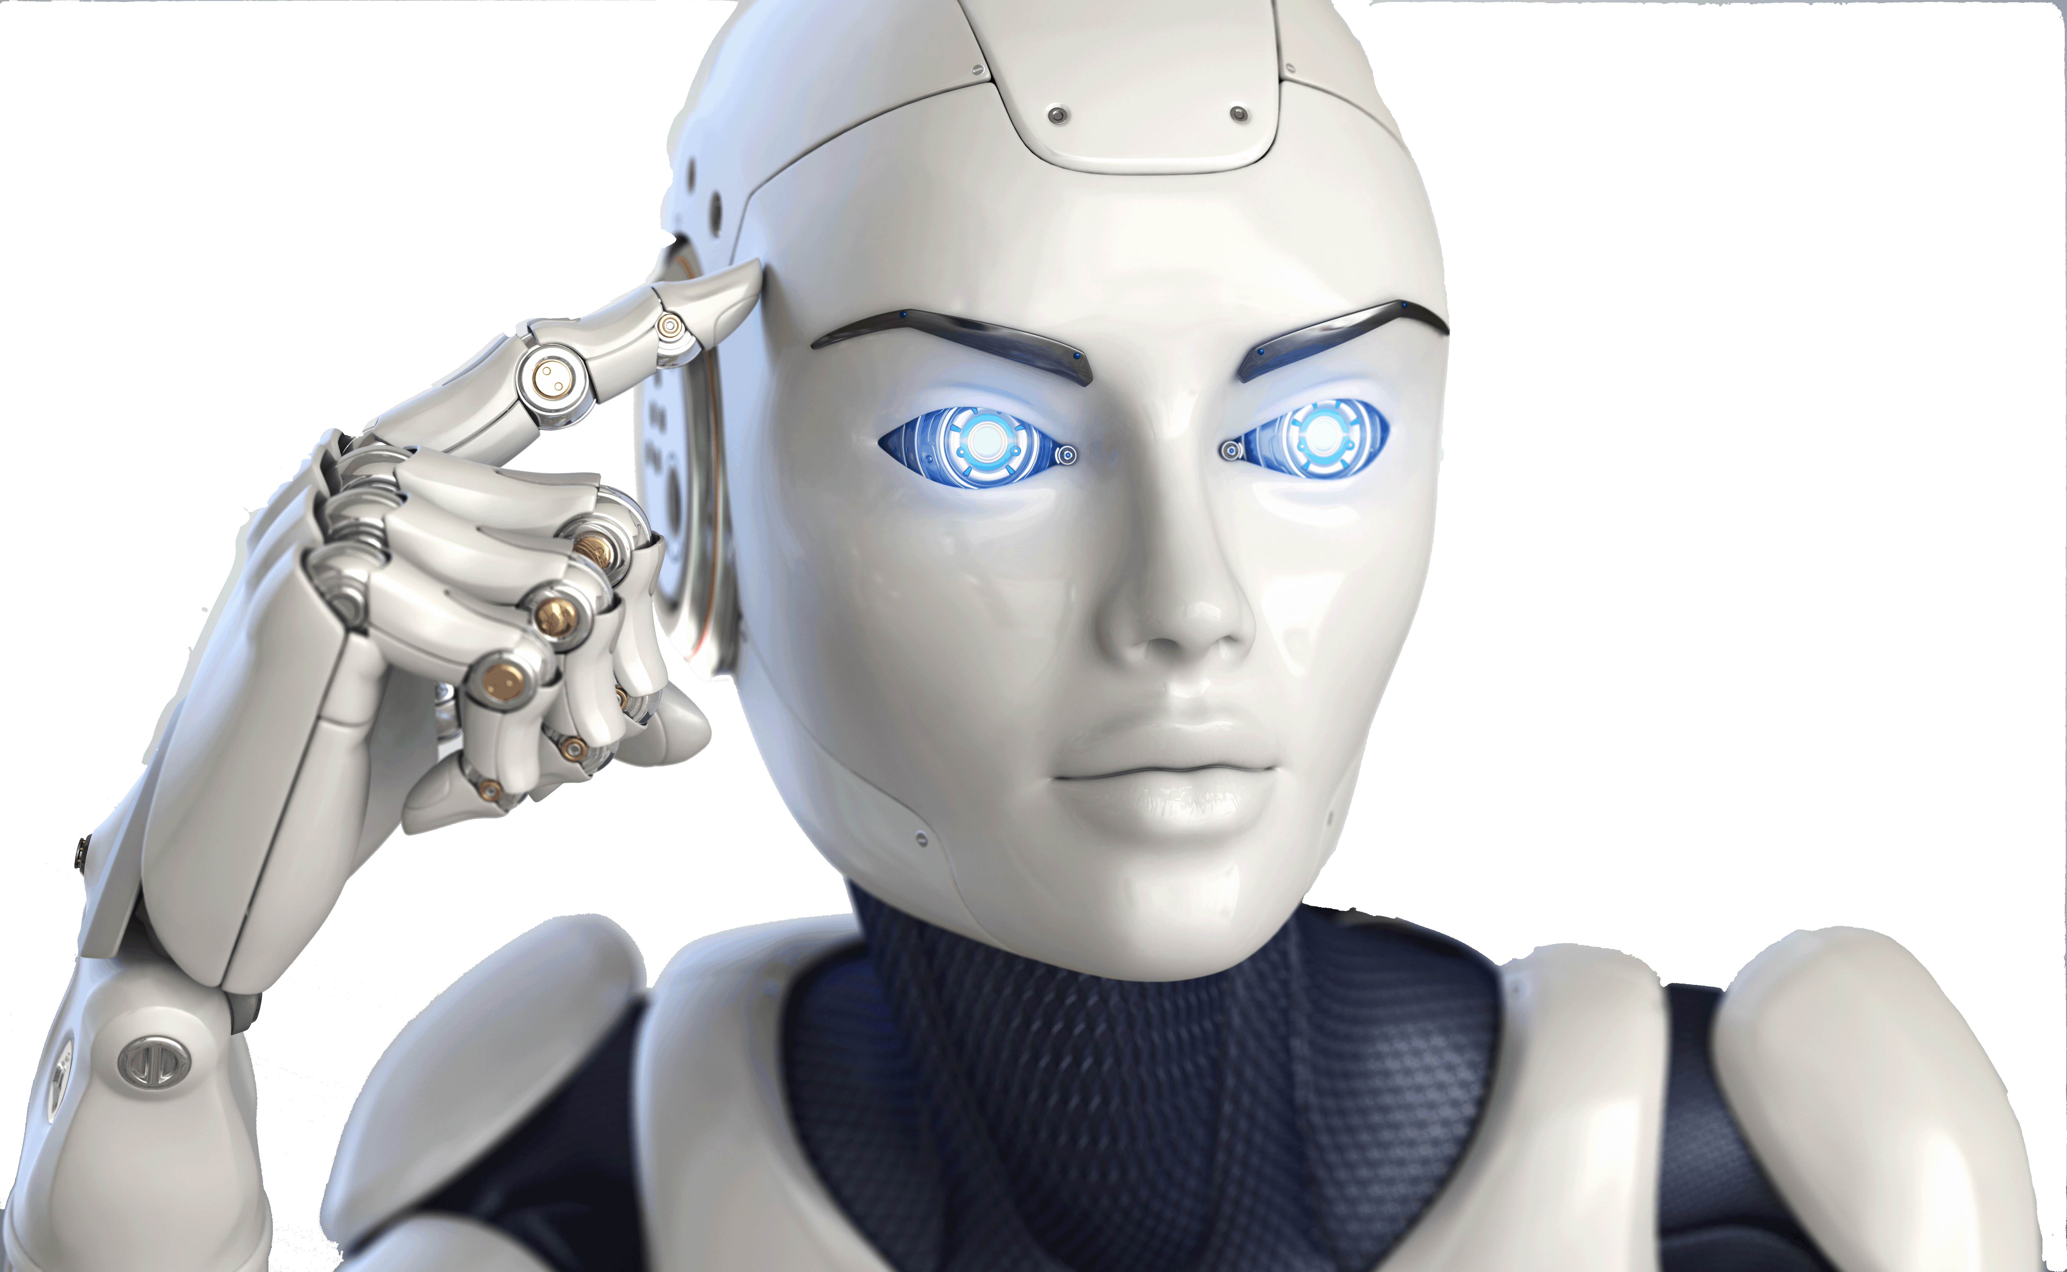
Brain Simulator II
From:
Charles Simon
http://FutureAI.guru

